Slide 1
INVENTORY

Slide 2
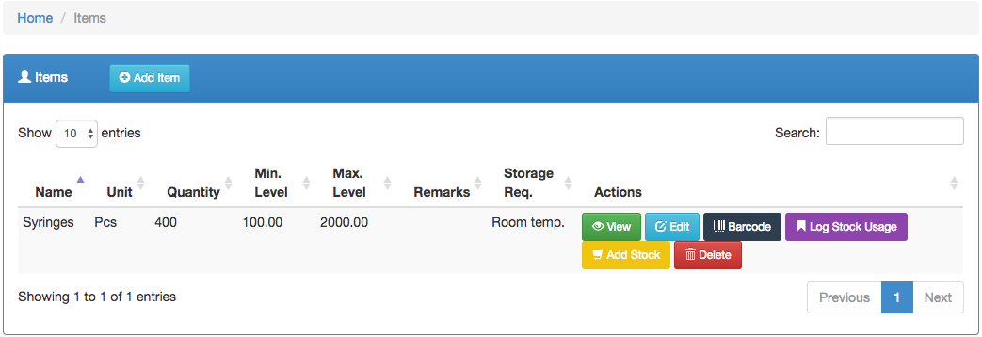
Inventory
Shows a list of all the available medical equipment

Slide 3
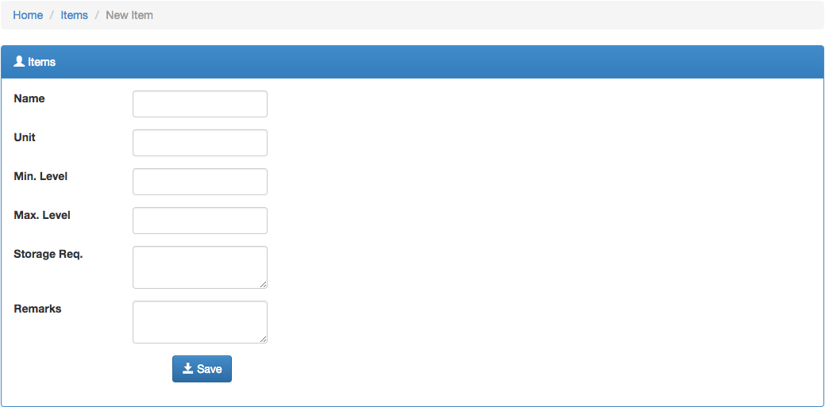
Continuation...
To add a new item click on the button, fill in the fields and save.

Slide 4


Continuation…
To view the details of a particular item click on the button
used to change or modify the details of a particular item
The can be printed out
To check the usage of an item click on the button
used to add more stock of a particular item
To delete an item click on the button

Slide 5
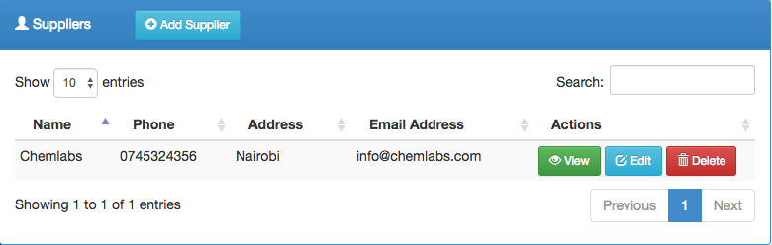
Suppliers
Shows a list of approved suppliers

Slide 6





Continuation….
To add a new supplier click on the button
The field allows one to search for a supplier
To view a particular suppliers details click on the button
The button enables one to edit a suppliers details
And the button, deletes a supplier

Slide 7
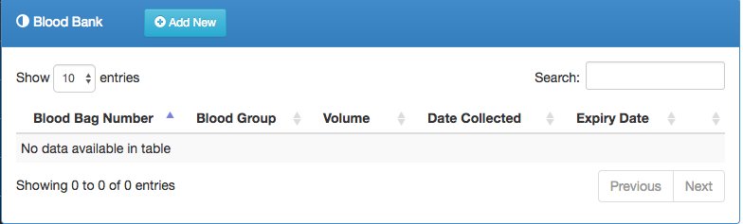
Blood bank
Contains all information pertaining blood.

Slide 8

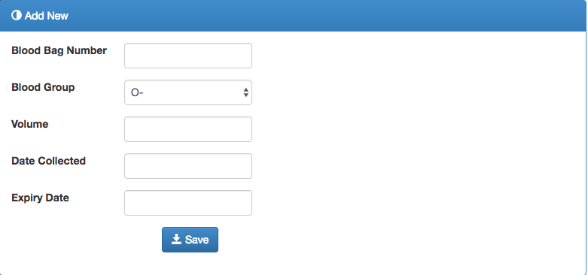
Continuation….
To add new blood information click on the button
Fill in all the fields, click on the button

Slide 9
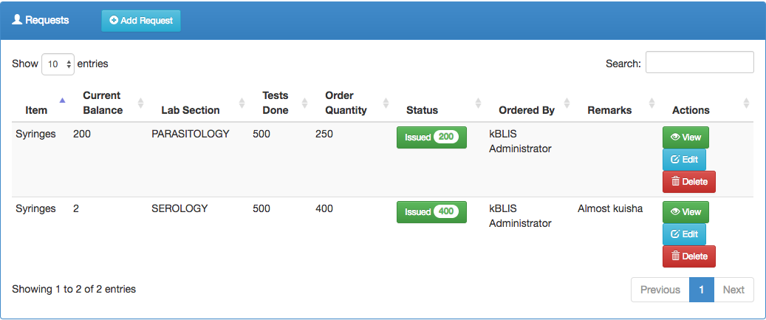
Requests
Shows requests made on the inventory

Slide 10
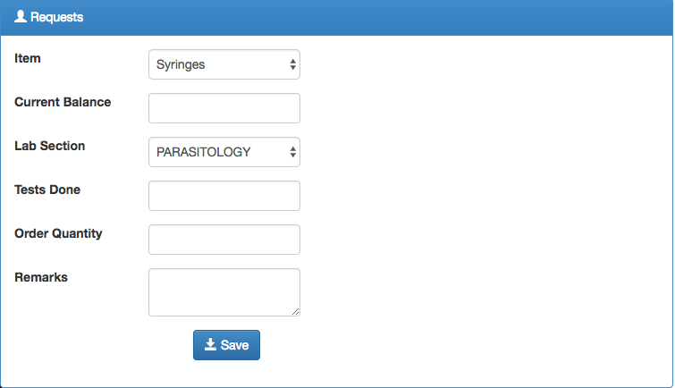
Continuation….
To add a new request click on the button, fill in the fields the click on save.

Slide 11


Continuation….
The field lets one search for a particular request
To edit a request, click on the button
To view a certain request click on the button

